Slide 1


Image of Brain Stroke Lesion segmented with X-Net and Quaternion Neural Network
Master’s degree in Artificial Intelligence and Robotics
Authors: Denise Landini - 1938388 Alessandro Lambertini - 1938390
Course: Neural Network
Professor: Aurelio Uncini
Academic Year: 2020-2021

Slide 2
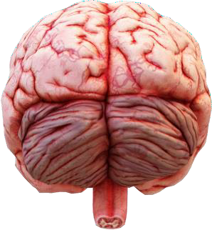


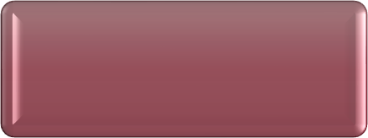
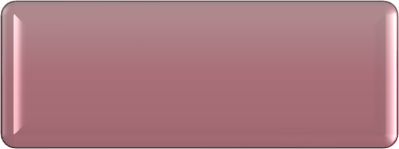




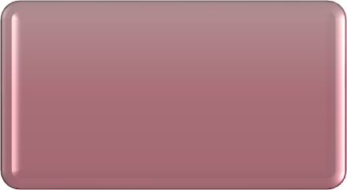


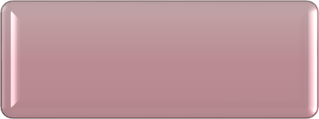
Pipeline followed
Pre-processing
Split
Model 1: X-Net
Models
Model 2: X-Net with quaternions
Evaluation
Pagina 2

Slide 3


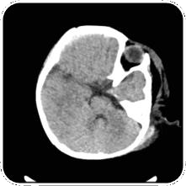

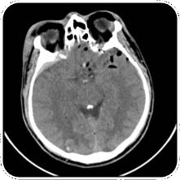





Dataset: Brain CT images with Interacranial Haemorrhage Masks
Pre-processing and split steps
The dataset is organized as follow:
Number of patients: 82
For each patient there are a few images that are related to different parts of the brain.
Total images: 2501
In pre-processing step, we obtain:
If the input image is a part of the brain
where a stroke lesion wasn’t found
we obtain a black image.
If the input image is a part of the brain where a stroke lesion was found
we obtain an image in which will be represented the stroke lesion.
Pre- processing
Split
Input
Output
Input
Output
Models
In split step we consider that is not correct to separate completely randomly the images that we have. So, we have splitted the 82 patients. randomly.
The data are splitted in 80% train set and 20% test set.
Evaluation
Pagina 3

Slide 4
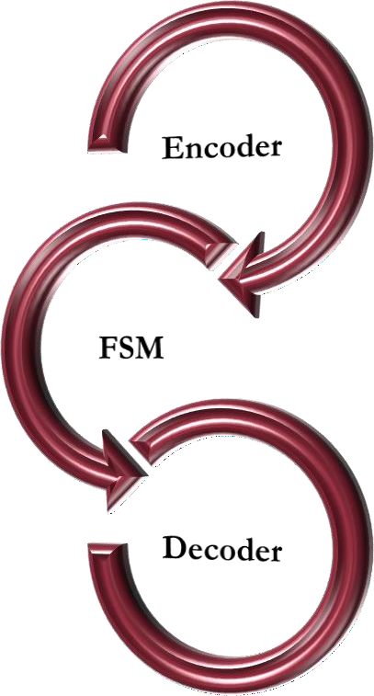
Model 1: X-Net
Complete architecture implemented
The architecture is composed by:
Encoder:
X-blocks have number of filters that vary at each step: 64, 128, 256, 512.
Maxpooling between X-blocks is always 2 × 2.
X-blocks 1024
Aim: produce high-dimensions feature maps.
FSM (Feature Similarity Module):
Non-local operation
Connects the Encoder to the Decoder
Aim: used to capture long-range spatial information
Decoder:
Pre- processing
Upsampling 2 × 2 and Convolution 3 × 3
Concatenate the previous block in the Encoder
X-blocks have number of filters that vary at each step: 512, 256, 128, 64
Split
Convolution 1 × 1 with “sigmoid” as activation function.
Model 1
Aim: recover the spatial resolution.
Evaluation
Pagina 3

Slide 5
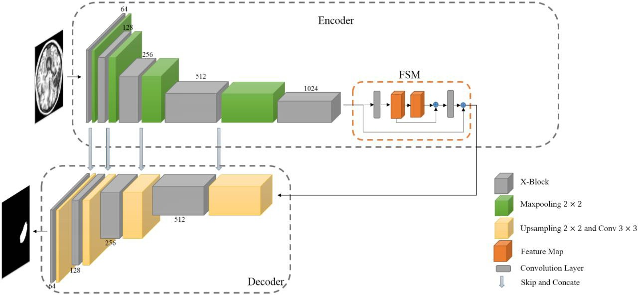
Model 1: X-Net
Motivation of methods used
We use Maxpooling because is a method of reducing the size of an image by splitting it into blocks and keeps only the one with the highest value. Doing this we reduce the problem of overfitting and only the area with grater activation are maintained.
We use UpSampling to double the dimensions of input.
The Concatenation is used to improve segmenting performance.
Input Image:
224 × 192 × 1
Input of FSM:
14 × 12 × 128
Pre- processing
Output of FSM Input Decoder
Split
Output Image
Model 1
Evaluation
Figure: X-Net architecture
Pagina 5

Slide 6
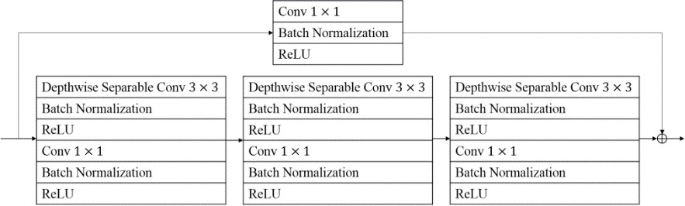
Model 1: X-Net
X-block structure
For each convolutional layer, both in the encoder and decoder, we use:
Batch Normalization that is a technique that allow to improve the velocity, performance and stability of a Neural Network. We use this in order to normalize the input.
Activation function: ReLU. We use this to introduce non linearity in the network and also because the
computation of the derivative is fast and its value is zero only if the input is less than zero.
In X-block we have two paths:
First path: the residual connection consist in 1 × 1 convolution layer to guarantee that the number of channels in output is equal to 𝐶_{𝑂}.
Second path:
Three depthwise separable convolution layers in cascade with kernel size 3 × 3
Convolution of size 1 × 1
Pre- processing
Split
Input feature map:
_{𝐼 ∈ 𝑅}𝐻×𝑊×𝐶_{𝑖}
𝐶_{𝑖} number of input channel
Output feature map:
_{O ∈ 𝑅}𝐻×𝑊×𝐶_{𝑂}
𝐶_{𝑂} number of output channel
Model 1
Figure: X-block structure
Evaluation

Slide 7
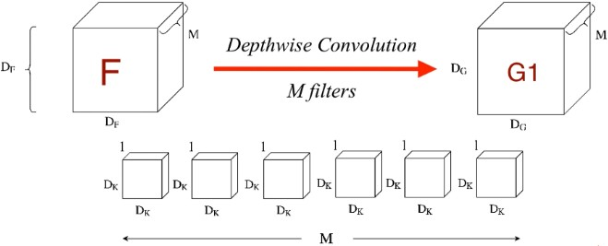

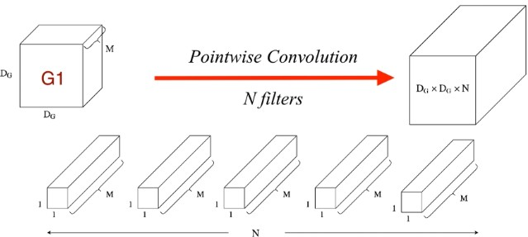
Depthwise Separable Convolutions (DSC)
Convolution with DSC
The process of convolution is broken in two different operations:
1. Depthwise convolutions: Filtering Stage
In this operation, instead of done the convolution for all the M channel, the convolution is applied to a single channel at a time.
Figure 1: Depthwise convolutions
2. Pointwise convolutions: Combination Stage
It involves performing the linear combination of each of these layers.
In this operation, we apply on the M channels, an operation of 1 × 1 convolution.
Pre- processing
Split
Figure 2: Pointwise convolutions
Advantages:
Reduce the number of trainable parameters
Reduce the computation time
Manage to improve efficiency without reducing effectiveness
Disadvantage:
Model 1
Not used in small network due to the small number of trainable parameters
Evaluation

Slide 8
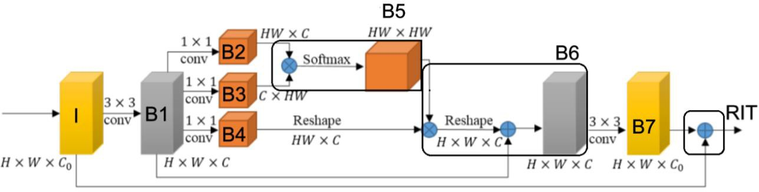
Model 1: X-Net
FSM: Details
FSM is designed to explore dense context information for effective brain lesion segmentation through extracting long-range dependencies.
Input feature map: 𝑋₀ ∈ 𝑅^{𝐻×𝑊×𝐶0} .
Convolution 3 × 3 over I ➔ B1
Aim: used to filter out the irrelevant feature from the input I, because of this we obtain a feature map with depth 𝐶 < 𝐶₀
Three convolutions:
1 × 1 ➔ B2
1 × 1 ➔ B3
1 × 1 ➔ B4 indicates the representation of the input signal.
B2 ⨂ B3 with softmax function ➔ B5.
Aim: relation map 𝑓(𝑥_{𝑖}, 𝑥_{𝑗}) which is the combination of dot product and softmax.
B4 ⨂ B5 ➔ B6
B6 has a wide range of contextual view and aggregates the long-range context.
Convolution 1 × 1 over B6, B1 ⨁ B6
Convolution 3 × 3 over B6 ➔ B7.
Aim: obtain the initial dimension of the feature map.
I ⨁ B7 ➔ output of FSM (RIT) Aim: avoid overfitting.
Pre- processing
Split
Model 1
Figure: FSM architecture
Evaluation

Slide 9
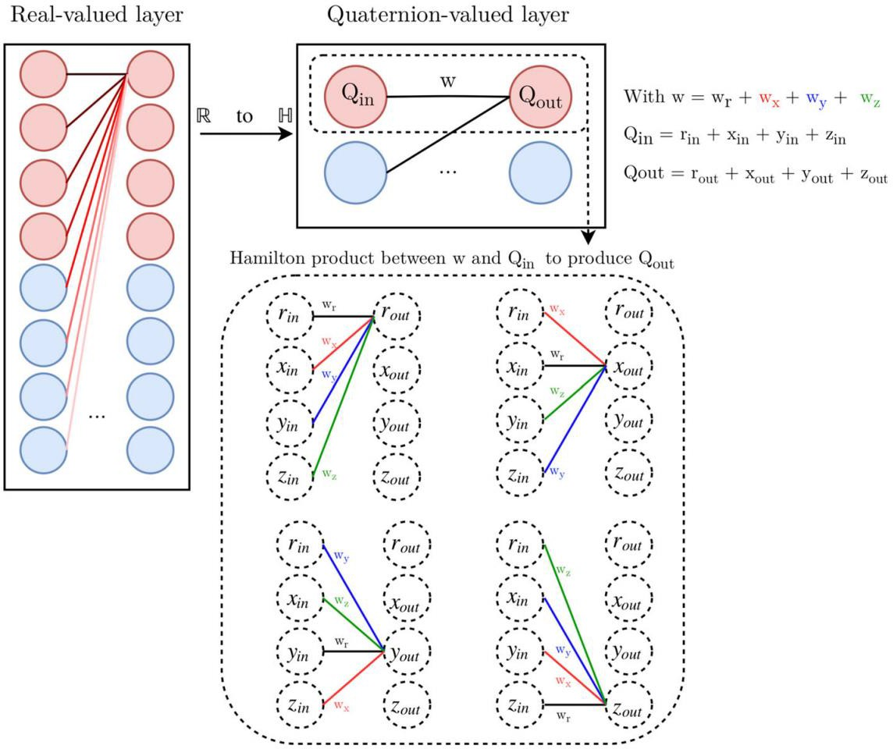
Model 2: X-Net with Quaternions
Introduction
Aim: process and build entities that are composed at maximum by four elements.
Quaternions uses Hamilton product
Can reconstruct the spatial relation within 3D coordinates and within colour pixels.
Advantages:
QNN has a fourfold memory than NNs.
QNN made efficient model in multidimensional space, because of
the natural multidimensional representation of quaternions and their ability to reduce the number of parameters.
QNN speed up computation
Pre- processing
Split
Model 2
Figure: Quaternion architecture
Evaluation

Slide 10
Model 2: X-Net with Quaternions
Implementation
Pre-progessing step
The black and white image were represented in the quaternion domain in the three complex channels in which
we have replicated the gray image, and the real channel was set to zero.
We have done this choice because we have images in black and white and not with colors.
If we have had the color images, we would set the primary color component for each channel.
Split step
The data are splitted in 80% train set and 20% test set.
Architecture
The implementation of the X-Net is the same that we have done for the first model.
So, we have the same structure of:
X-block
Encoder
FSM
Decoder
Pre- processing
Split
The crucial differences are that:
we have adapted the Depthwise Separable Convolution class in order to work with quaternions. In particular, we have substitute the Convolution with quaternions convolutions.
in all this implementation we have added the forward function and we have modified the dimension of all the element in the network to fit the quaternion.
Model 2
Evaluation

Slide 11
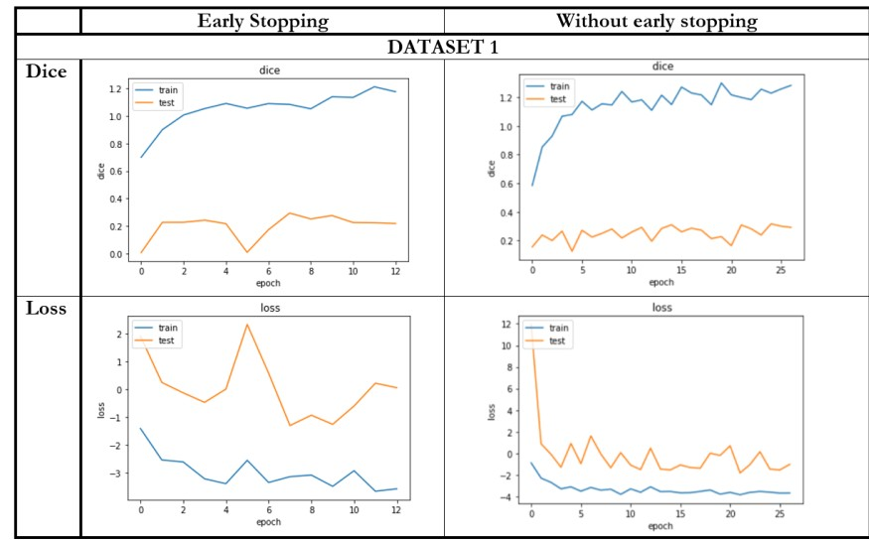
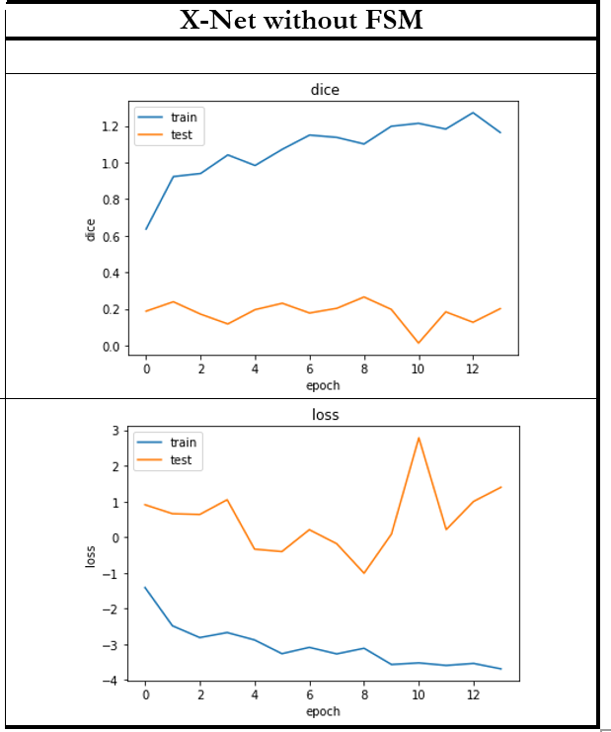
Evaluation with Model 1
X-Net: metrics and experiments
Metrics used: Experiments done:
Dice score: •
2 ⋅ 𝐴𝑟𝑒𝑎 𝑜𝑓 𝑂𝑣𝑒𝑟𝑙𝑎𝑝
Train of X-Net with and without Early Stopping
Train of X-net with Early Stopping considering FSM and without considering FSM.
𝑡𝑜𝑡𝑎𝑙 𝑝𝑖𝑥𝑒𝑙𝑠 𝑐𝑜𝑚𝑏𝑖𝑛𝑒𝑑
Loss function:
𝐵𝑖𝑛𝑎𝑟𝑦𝐶𝑟𝑜𝑠𝑠𝐸𝑛𝑡𝑟𝑜𝑝𝑦 + (1 − 𝐷𝑖𝑐𝑒)
Pre- processing
Split Train
Evaluation 1
Figure: Comparisons
Pagina 11

Slide 12
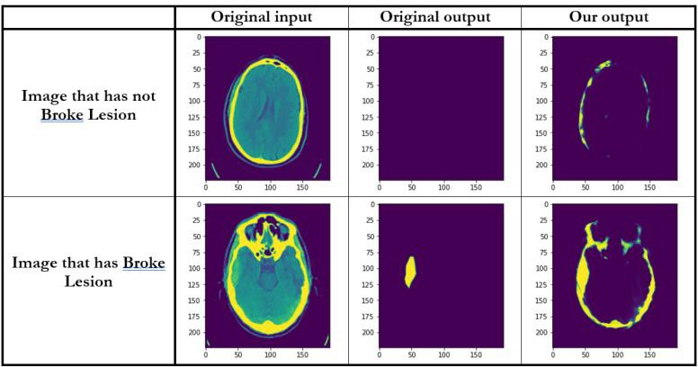
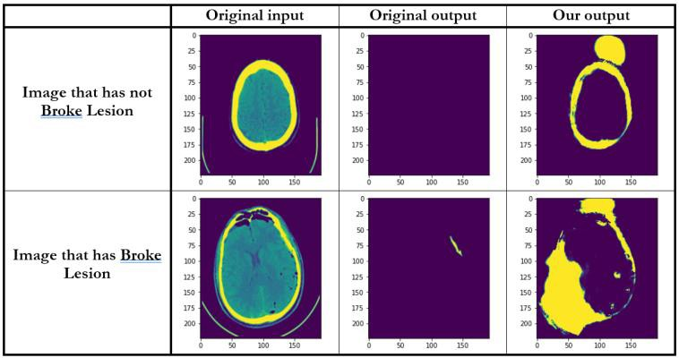
Evaluation with Model 1
X-Net: the importance of FSM for the output
If we cut the bone from the end image, we will have a perfectly segmentation of the lesion.
We can cut the bone because we have a folder in which
are store the images.
Even if we cut the bone from the end image, we will not have a perfectly segmentation of the lesion because the problem is that we have a big area that are marked in our output and not only those of the bones
Problems
Pre- processing
Split
Figure 1: Random samples X-Net with FSM
Figure 2: Random samples X-Net without FSM
BETTER
Train
The work of FSM is very important in order to avoid the problem in Figure 2.
Evaluation 1

Slide 13
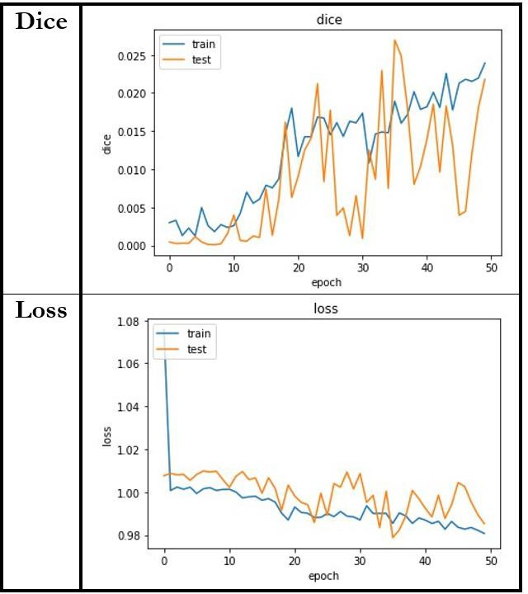
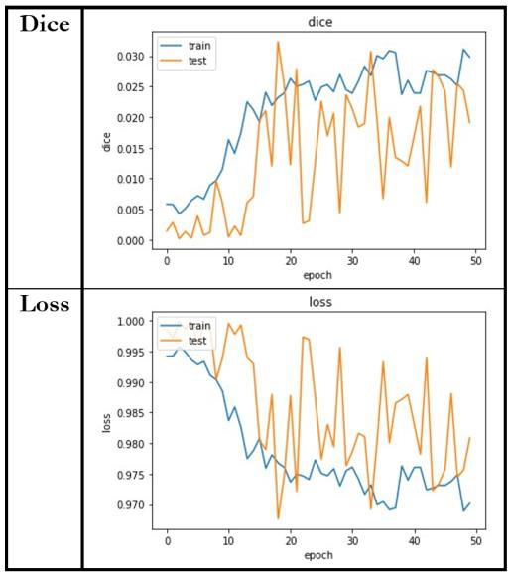
Evaluation with Model 2
X-Net with Quaternions: metrics and experiments
Pre- processing
Figure 1: Dice and loss for X-Net using Loss function 1
𝐿𝑜𝑠𝑠 𝑓𝑢𝑛𝑐𝑡𝑖𝑜𝑛 1 = 𝐵𝑖𝑛𝑎𝑟𝑦𝐶𝑟𝑜𝑠𝑠𝐸𝑛𝑡𝑟𝑜𝑝𝑦 + (1 − 𝐷𝑖𝑐𝑒)
Figure 2: Dice and loss for X-Net using Loss function 2
𝐿𝑜𝑠𝑠 𝑓𝑢𝑛𝑐𝑡𝑖𝑜𝑛 2 = 1 − 𝐷𝑖𝑐𝑒
Split
For dice we have the same behaviour that we have in Figure 2
Better result for loss function
BETTER
The results is not so good.
Train set increasing the dice and decreasing the loss.
Test set has the same behaviour of the train set, but it presents a lot of peaks.
Train
Conclusion: if we train more the QNN, we can obtain
Evaluation 2
better results.
17/03/2021
Pagina 13

Slide 14
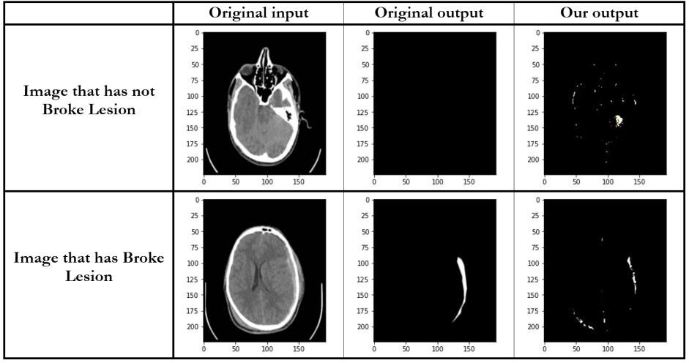
Evaluation with Model 2
X-Net with Quaternions: output obtained
Motivation of results obtianed:
the number of epochs that we have chosen is not sufficient for a quaternion network
it is probably that our dataset is not big enough
this structure of the network might not adapt
to quaternions
the choices that we have done to represent the images in the quaternion domain is not adapt.
Problem: we have a white point so marked
Pre- processing
Comments:
image that has not the broke lesion, the result is not good, because we have a white point so marked
image that has broke lesion is good, because it highlights the problem that the patient has
Split
Figure: Random samples X-Net with quaternions
Train
Evaluation 2
Pagina 14

Slide 15
Comparisons of results obtained
Conclusion
Model | Dice | #Parameters
X-Net | 0.2188 | 15.1M
X-Net (paper) | 0.4867 | 15.1M
X-Net quaternion | 0.0230 | 26.5M
Table: Comparisons between models
We have only the 6% of data with respect to ATLAS (dataset used in paper). So, we have
obtained the final dice = 0.2188 that is good compared to 0.4867 (paper)
Pre- processing
X-Net has a better Dice value with respect to X-Net with quaternions, but maybe is not true if we will train again X-Net with quaternions.
Split
X-Net with quaternions has the number of parameters that is almost double respect to which of
the X-Net.
Train
Evaluation
Pagina 15

Slide 16
Thanks for the attention!
Denise Landini Alessandro Lambertini

